Slide 1
Todo List Application
Members: Alex Nguyen, Krystal Phan, Jair De Orta

Slide 2
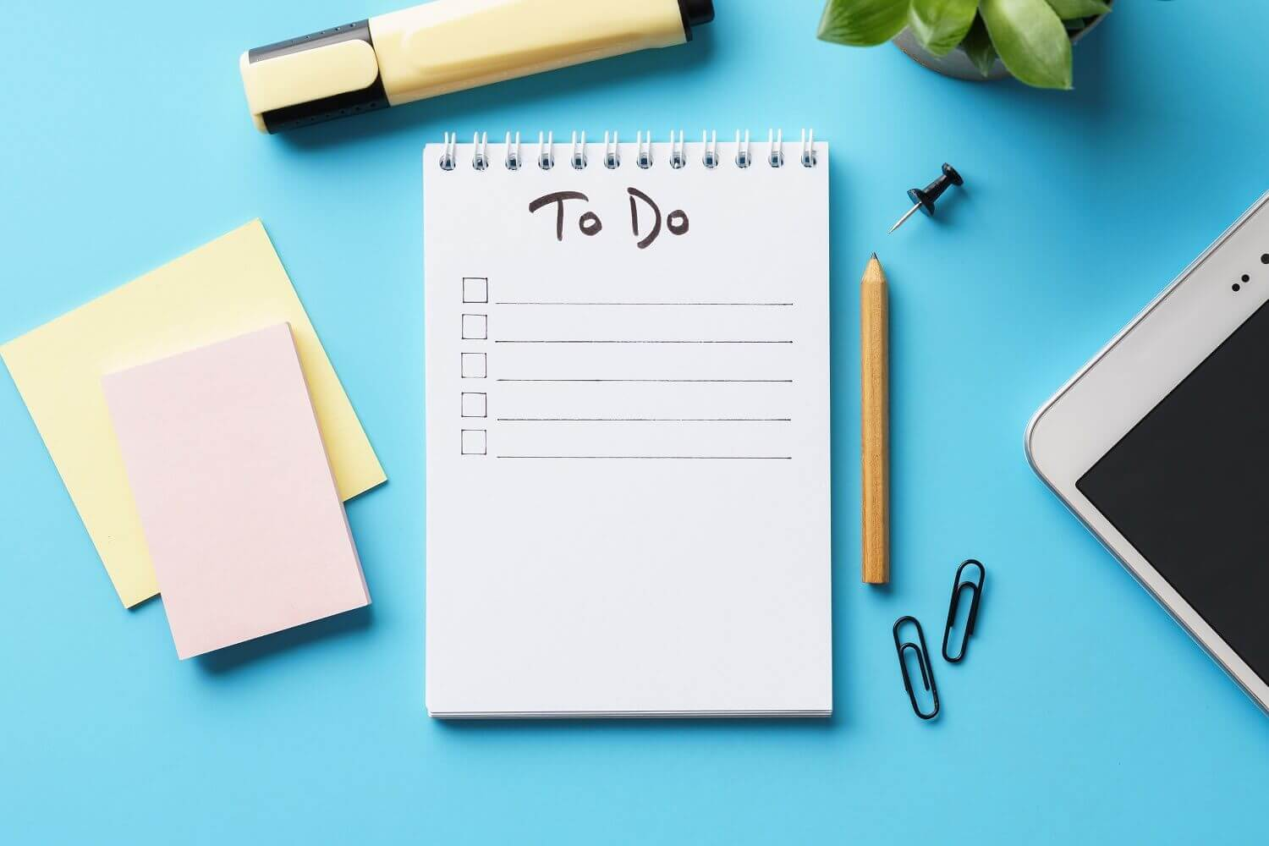
Introduction to Application
This application was a simple but useful tool that many people can use.
Most people can use a todo list in everyday life and it is simple to use such an application.

Slide 3
Steps to Use the Application
Our application is a todo list where the user can register for an account on the website application. And under the user’s account, a todo can be added. Which can include descriptions to the task added. The task also once added, can display the time it was added and the due date for it.
It can also be edited to mark whether the task is completed or not. The description, title, and the due date time can be changed if needed as well.
The task can be deleted from the list if the use for it, is not needed anymore.

Slide 4



Software Used
Pycharm was used to edit the python code for this application.
Django was used to help set up a web framework for us to work on.
Heroku is a linux-based cloud service where users can host websites online for 7 bucks.
Notes:
alex

Slide 5

Version Control
The version control system used was github.
Everyone know github, but it helped to keep track of the changes we made to the application. From when the change was made to what exact change was to the code.
It helped keep us organized when making the application.
Notes:
alex

Slide 6
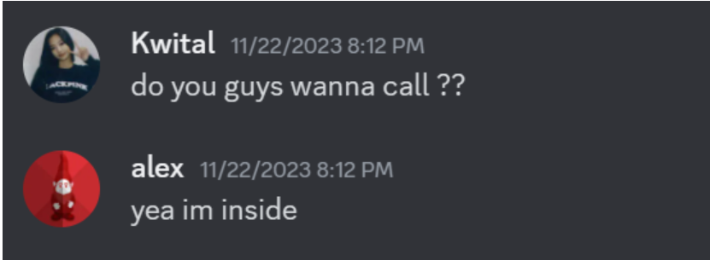
Communication
Pretty much all communication was done through discord.
While some communication was through messages, mostly before meeting up. We physically met in class to choose the idea for the application.
But afterwards, all communication was done through voice calls on discord and worked together to make the web application.

Slide 7
Issues
Some issues that occurred was the use of the framework where we took time to understand and implement what we learned into making the application.
Another issue that occurred was the mistiming in committing into github. It occurred once where we committed with a previous version than the newest version since we were all working at the same time. This was quickly resolved by pulling the the newest version that was overwritten and adding the changes made. This made us avoid this issue again.
And of course, the issue of making time when to meet. Since we all had to deal with work, life and especially school work.

